Slide 1
UPPER SIXTH ARTS
GEOGRAPHY
Lesson 12
Current Trends in Urbanisation
Notes:
Good morning, class, and welcome to our geography lesson. I am your geography teacher, Mr Kamdem. Today we are starting Lesson 12: Current Trends in Urbanisation.

Slide 2
CLASS INFO
Class, Chapter and Duration
Class | Upper Sixth Arts
Chapter | Module 5: Understanding and managing settlement dynamics across the world in general and Cameroon in particular
Duration | 2 periods (2 × 50 minutes)
Notes:
This lesson is for Upper Sixth Arts. It belongs to Module 5: Understanding and managing settlement dynamics across the world in general and Cameroon in particular. We shall need 2 periods to cover it.

Slide 3
IDENTIFICATION
Lesson Identification
Topic | Urban Settlement and Urbanisation
Sub-topic | Urbanisation
Lesson | Lesson 12: Current Trends in Urbanisation
Notions / Concepts | Suburbanisation, counter-urbanisation, re-urbanisation, centripetal forces, centrifugal forces, gentrification.
Syllabus focus | Suburbanisation, counter-urbanisation and re-urbanisation: causes and consequences; centripetal and centrifugal forces.
Competence | Learners are able to explain the recent stages of urban change.
Notes:
Our topic is Urban Settlement and Urbanisation, and the sub-topic is Urbanisation. The key notions we shall use today are: suburbanisation, counter-urbanisation, re-urbanisation, centripetal forces, centrifugal forces, gentrification. At the end, you should be able to do this: learners are able to explain the recent stages of urban change.

Slide 4

HOMEWORK CORRECTION
Correction of the Homework
Question (Lesson 11: Urbanisation):
List three urban problems of your town and a solution for each.
Notes:
Before we start the new lesson, let us correct the homework I gave you at the end of Lesson 11: Urbanisation. The question was: List three urban problems of your town and a solution for each. Take out your exercise books.

Slide 5
HOMEWORK CORRECTION
Correction: Possible Answer
Examples: traffic jams – build more roads and use buses; flooding – clean and enlarge drains; unemployment – support small businesses and vocational training.
Notes:
Here is a good answer. Examples: traffic jams – build more roads and use buses; flooding – clean and enlarge drains; unemployment – support small businesses and vocational training. Compare it with your own answer and correct your work in red.

Slide 6
LESSON PLAN
Lesson Plan
Correction of the homework
Objectives and recall
Real-life situation and action to take
Learning activities
Board summary
Evaluation, remediation and homework
Notes:
Here is the plan of our lesson today. First, we shall correct the homework. Then we shall look at the objectives and recall what you already know. After that, we shall study a situation from real life and the action to take, and do the learning activities. Finally, we shall copy the board summary, do the evaluation and the remediation, and I will give you the homework.

Slide 7
OBJECTIVES
Objectives
By the end of this lesson, you should be able to:
Explain suburbanisation.
Explain counter-urbanisation.
Explain re-urbanisation and centripetal and centrifugal forces.
Notes:
By the end of this lesson, you should be able to do three things. Number 1: explain suburbanisation. Number 2: explain counter-urbanisation. Number 3: explain re-urbanisation and centripetal and centrifugal forces.

Slide 8
PREVIOUS KNOWLEDGE
Previous Knowledge
Cities grow with urbanisation.
Cities have a centre and suburbs.
Notes:
Let us first remember what you already know. Cities grow with urbanisation. Cities have a centre and suburbs. Keep this in mind, because we shall build on it today.

Slide 9
REAL-LIFE SITUATION
Situation in Real Life
In London, rich families first left the centre for the suburbs, then some moved to villages. Now young professionals are moving back into renewed flats in the old docks.
Notes:
Listen carefully to this situation from real life. In London, rich families first left the centre for the suburbs, then some moved to villages. Now young professionals are moving back into renewed flats in the old docks. Think about it, because I am going to ask you some questions.

Slide 10
REAL-LIFE SITUATION
Situation: Question 1
What is the problem in the situation?
Notes:
Question 1: What is the problem in the situation? Think for a moment, then raise your hand to answer.

Slide 11
REAL-LIFE SITUATION
Answer
People move in and out of cities in stages.
Notes:
Good. People move in and out of cities in stages.

Slide 12
REAL-LIFE SITUATION
Situation: Question 2
What is moving to the suburbs called?
Notes:
Question 2: What is moving to the suburbs called? Think for a moment, then raise your hand to answer.

Slide 13
REAL-LIFE SITUATION
Answer
Suburbanisation.
Notes:
Good. Suburbanisation.

Slide 14
REAL-LIFE SITUATION
Situation: Question 3
What is moving back to the centre called?
Notes:
Question 3: What is moving back to the centre called? Think for a moment, then raise your hand to answer.

Slide 15
REAL-LIFE SITUATION
Possible Answer
Re-urbanisation.
Notes:
Good. Re-urbanisation.

Slide 16
ACTION TO TAKE
Action to Take
Recognise current urban trends in our towns and plan for them.
Notes:
From this situation, the action we are working towards in this lesson is the following: recognise current urban trends in our towns and plan for them.

Slide 17
JUSTIFICATION
Justification of the Lesson
This lesson helps us to understand how cities in MEDCs change and what may happen in our cities.
Notes:
Why is this lesson important for you? This lesson helps us to understand how cities in MEDCs change and what may happen in our cities.

Slide 18
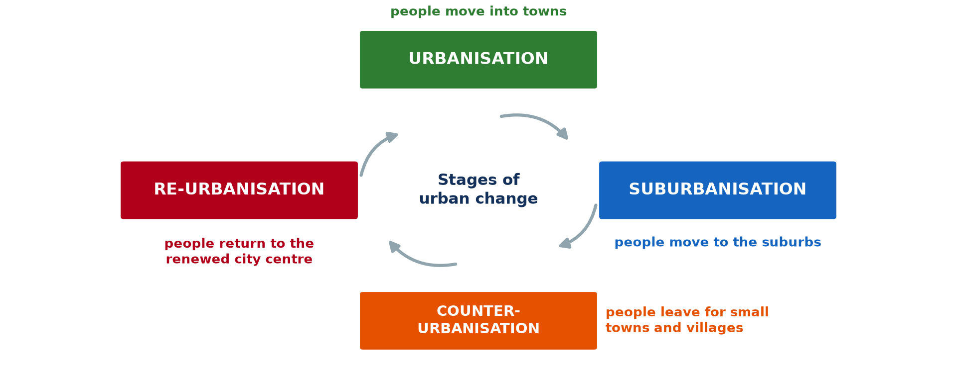
1. STAGES OF URBAN CHANGE
Activity 1
Stages of urban change.
Notes:
Activity 1. Look carefully at this diagram: stages of urban change. Observe every detail before I ask the question.

Slide 19
1. STAGES OF URBAN CHANGE
Activity 1: Question
Name the four stages of urban change.
Notes:
Here is the question for Activity 1: Name the four stages of urban change. Take one minute to think and write your answer in your rough notebook.

Slide 20
1. STAGES OF URBAN CHANGE
Activity 1: Answer
Urbanisation, suburbanisation, counter-urbanisation, re-urbanisation.
Notes:
Let us check the answer together. Urbanisation, suburbanisation, counter-urbanisation, re-urbanisation.

Slide 21

2. SUBURBANISATION
Activity 2
Suburbs from the air (Chicago).
Notes:
Activity 2. Look carefully at this picture: suburbs from the air (Chicago). Observe every detail before I ask the question.

Slide 22
2. SUBURBANISATION
Activity 2: Question
Give two causes of suburbanisation.
Notes:
Here is the question for Activity 2: Give two causes of suburbanisation. Take one minute to think and write your answer in your rough notebook.

Slide 23
2. SUBURBANISATION
Activity 2: Answer
Cars and better roads, and the wish for space and quiet.
Notes:
Let us check the answer together. Cars and better roads, and the wish for space and quiet.

Slide 24

3. COUNTER-URBANISATION
Activity 3
Countryside with farms.
Notes:
Activity 3. Look carefully at this picture: countryside with farms. Observe every detail before I ask the question.

Slide 25
3. COUNTER-URBANISATION
Activity 3: Question
Why do some city people move to the countryside?
Notes:
Here is the question for Activity 3: Why do some city people move to the countryside? Take one minute to think and write your answer in your rough notebook.

Slide 26
3. COUNTER-URBANISATION
Activity 3: Answer
For quiet, clean air and cheaper houses; working from home.
Notes:
Let us check the answer together. For quiet, clean air and cheaper houses; working from home.

Slide 27
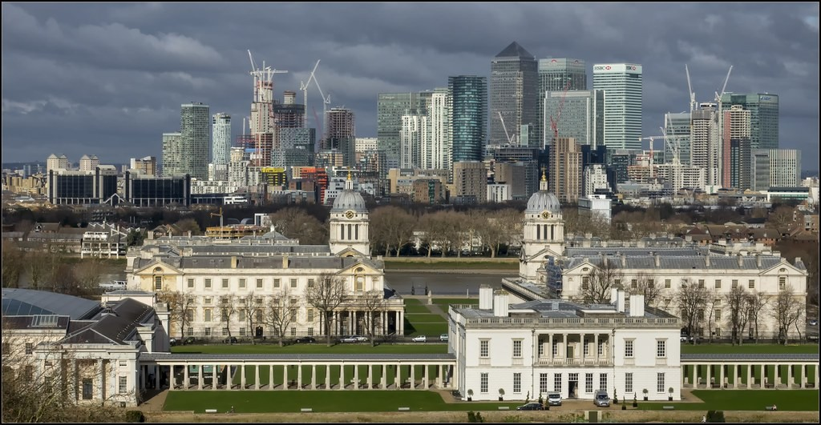
4. RE-URBANISATION
Activity 4
Old and new buildings: London Docklands.
Notes:
Activity 4. Look carefully at this picture: old and new buildings: London Docklands. Observe every detail before I ask the question.

Slide 28
4. RE-URBANISATION
Activity 4: Question
What attracts people back to the city centre?
Notes:
Here is the question for Activity 4: What attracts people back to the city centre? Take one minute to think and write your answer in your rough notebook.

Slide 29
4. RE-URBANISATION
Activity 4: Answer
Renewed housing, jobs and services close by.
Notes:
Let us check the answer together. Renewed housing, jobs and services close by.

Slide 30
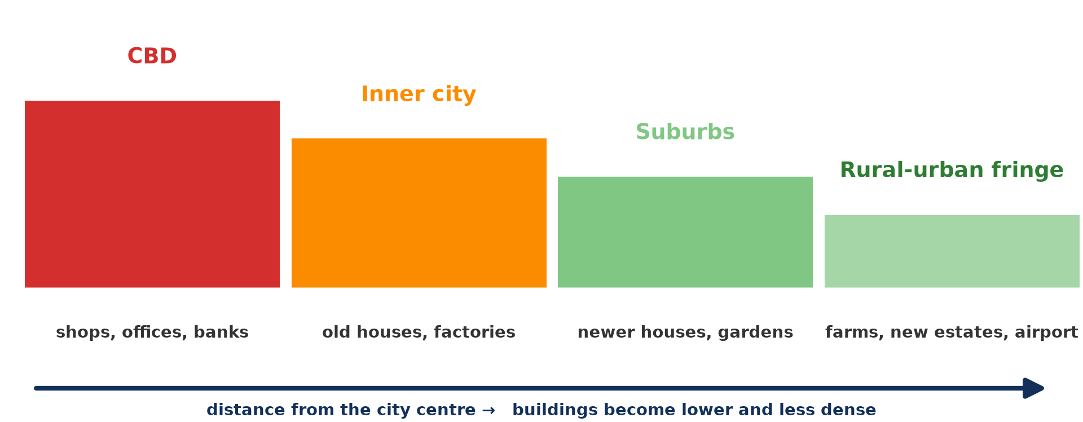
5. CENTRIPETAL AND CENTRIFUGAL FORCES
Activity 5
Zones of the city.
Notes:
Activity 5. Look carefully at this diagram: zones of the city. Observe every detail before I ask the question.

Slide 31
5. CENTRIPETAL AND CENTRIFUGAL FORCES
Activity 5: Question
Distinguish centripetal and centrifugal forces.
Notes:
Here is the question for Activity 5: Distinguish centripetal and centrifugal forces. Take one minute to think and write your answer in your rough notebook.

Slide 32
5. CENTRIPETAL AND CENTRIFUGAL FORCES
Activity 5: Answer
Centripetal forces pull people to the centre; centrifugal forces push them out.
Notes:
Let us check the answer together. Centripetal forces pull people to the centre; centrifugal forces push them out.

Slide 33
BOARD SUMMARY
Board Summary
Topic: Urban Settlement and Urbanisation
Sub-topic: Urbanisation
Lesson 12: Current Trends in Urbanisation
Notes:
Now we are going to copy the board summary. Write the title and the headings neatly in your notebooks. I will give you enough time for each slide, so do not rush.

Slide 34
BOARD SUMMARY
DEFINITIONS
The key terms of this lesson are defined as follows:
Centripetal forces: They are forces that attract people and activities to the city centre.
Notes:
Let us copy the definitions. The key terms of this lesson are defined as follows. On this slide we have Centripetal forces. Write each point on a new line, with the key term first, and explain it in your own words when we revise. When you finish, we go to the next slide.

Slide 35
BOARD SUMMARY
DEFINITIONS (continued)
Centrifugal forces: They are forces that push people and activities away from the centre.
Notes:
We continue with the definitions. On this slide we have Centrifugal forces. Write each point on a new line, with the key term first, and explain it in your own words when we revise.

Slide 36
BOARD SUMMARY
1. Current Trends in Urbanisation
Towns in MEDCs have gone through the following trends:
Suburbanisation: People and activities move from the inner city to the suburbs, helped by cars and cheaper land. It causes urban sprawl and commuting.
Notes:
Let us copy Current Trends in Urbanisation. Towns in MEDCs have gone through the following trends. On this slide we have Suburbanisation. Write each point on a new line, with the key term first, and explain it in your own words when we revise. When you finish, we go to the next slide.

Slide 37
BOARD SUMMARY
1. Current Trends in Urbanisation (continued)
Counter-urbanisation: People move from cities to small towns and villages in search of a quieter life and cheaper houses. Telecommuting and retirement encourage it.
Notes:
We continue with Current Trends in Urbanisation. On this slide we have Counter-urbanisation. Write each point on a new line, with the key term first, and explain it in your own words when we revise. When you finish, we go to the next slide.

Slide 38
BOARD SUMMARY
1. Current Trends in Urbanisation (continued)
Re-urbanisation: People move back into renewed city centres to be near jobs and entertainment. Gentrification and regeneration schemes such as the London Docklands attract them.
Notes:
We continue with Current Trends in Urbanisation. On this slide we have Re-urbanisation. Write each point on a new line, with the key term first, and explain it in your own words when we revise.

Slide 39
BOARD SUMMARY
1. Current Trends in Urbanisation
Illustration: stages of urban change
Notes:
Now draw this illustration in your notebook: stages of urban change. Give it a title and label it clearly.

Slide 40
BOARD SUMMARY
2. Causes and Consequences
These trends have causes and consequences:
Centripetal and centrifugal forces: Jobs, services and accessibility attract people to the centre. Congestion, pollution, high rents and crime push them out.
Notes:
Let us copy Causes and Consequences. These trends have causes and consequences. On this slide we have Centripetal and centrifugal forces. Write each point on a new line, with the key term first, and explain it in your own words when we revise. When you finish, we go to the next slide.

Slide 41
BOARD SUMMARY
2. Causes and Consequences (continued)
Consequences: Suburbanisation empties inner cities and increases traffic. Re-urbanisation renews centres but may push poor residents out.
Notes:
We continue with Causes and Consequences. On this slide we have Consequences. Write each point on a new line, with the key term first, and explain it in your own words when we revise.

Slide 42
FORMATIVE EVALUATION
Evaluation 1
Define counter-urbanisation.
Notes:
Now let us check what you have understood. Question 1: Define counter-urbanisation. Answer in your exercise book.

Slide 43
FORMATIVE EVALUATION
Expected Answer
The movement of people from cities to small towns and villages.
Notes:
The expected answer is: the movement of people from cities to small towns and villages. If you got it right, well done.

Slide 44
FORMATIVE EVALUATION
Evaluation 2
Give one centripetal and one centrifugal force.
Notes:
Now let us check what you have understood. Question 2: Give one centripetal and one centrifugal force. Answer in your exercise book.

Slide 45
FORMATIVE EVALUATION
Expected Answer
Centripetal: jobs in the centre. Centrifugal: high land prices.
Notes:
The expected answer is: centripetal: jobs in the centre. Centrifugal: high land prices. If you got it right, well done.

Slide 46
REMEDIATION
Remediation
Fill in the blanks:
Movement to the suburbs is ______.
Movement back to the centre is ______.
Forces pushing people outward are ______.
Notes:
For those who need more practice, fill in the blanks in your exercise book. The answers are: number 1, suburbanisation; number 2, re-urbanisation; number 3, centrifugal.

Slide 47
HOMEWORK
Homework
Which of the four stages is happening in your town? Give evidence.
Notes:
For your homework: Which of the four stages is happening in your town? Give evidence. We shall correct it at the beginning of our next lesson.

Slide 48
NEXT LESSON
Next Lesson
Our next lesson will be on:
Lesson 13: Urban Regions: Millionaire Cities, Conurbations and Megalopolis
Notes:
Our next lesson will be on Lesson 13: Urban Regions: Millionaire Cities, Conurbations and Megalopolis. Thank you for your attention, and see you next time.

Slide 49
BILINGUAL GAME
Bilingual Game (Jeu Bilingue)
English | Français
Suburb | La banlieue
Suburbanisation | La périurbanisation
Counter-urbanisation | La contre-urbanisation
Gentrification | La gentrification
Centre | Le centre-ville
Force | La force
Notes:
Let us play the bilingual game. I say a word in English, and you give me the French word. Then we do the reverse.

Slide 50
LOGBOOK
Official Logbook (1/2)
Module / Topic | Urban Settlement and Urbanisation
Lesson Title | Lesson 12: Current Trends in Urbanisation
Expected Learning Outcomes | Explain suburbanisation. Explain counter-urbanisation. Explain re-urbanisation and centripetal and centrifugal forces.
Competence | Learners are able to explain the recent stages of urban change.
Notes:
I record this information in the official logbook of the class after the lesson.

Slide 51
LOGBOOK
Official Logbook (2/2)
Matter Taught | DEFINITIONS; Current Trends in Urbanisation; Causes and Consequences.
Evaluation | Formative evaluation and remediation exercise.
Homework | Which of the four stages is happening in your town? Give evidence.
Enrolment / Present / Absent | ____ / ____ / ____
Achievement | To be completed after the lesson.
Notes:
I complete the second page of the logbook: the matter taught, the evaluation, the homework and the attendance.

Slide 52
TEACHER'S NOTE
Teacher's Note
Timing: Homework correction, plan, objectives 8 min | Recall, situation, action 10 min | 5 activities 30 min | Board summary (copying) 30 min | Evaluation, remediation 10 min | Homework, next lesson 5 min | Logbook 7 min
Without the projector (Activity 1): draw the cycle.
Without the projector (Activity 2): discuss new quarters.
Without the projector (Activity 3): discuss retirees going home.
Without the projector (Activity 4): describe renewal.
Without the projector (Activity 5): list each force.
Notes:
This slide is for me, the teacher: it gives the timing of the lesson and what to do if the projector is not available.

Slide 53
REFERENCES
References
National Geography Syllabus, MINESEC/IGE/IP-SS, 2019 — Module 5 (Settlement Geography).
Photo, Activity 2: “Chicago suburbs from the air” by Scorpions and Centaurs, CC BY-NC-SA 2.0, via Flickr (https://www.flickr.com/photos/62736719@N00/2912708983)
Photo, Activity 3: “Timid” by tricky (rick harrison), CC BY-NC-SA 2.0, via Flickr (https://www.flickr.com/photos/81851211@N00/205287304)
Photo, Activity 4: “Old & new: University Greenwich, The Queen's House & London Docklands” by Bert Kaufmann, CC BY-NC 2.0, via Flickr (https://www.flickr.com/photos/22746515@N02/26742366958)
Diagrams and animations: drawn for this lesson (Geography Department).
Notes:
These are the references and picture credits used to prepare this lesson.

